Slide 1
Real life project work examples of Service Oriented Architecture (SOA)
Scope of this presentation is to present my real-life project work examples Service Oriented Architecture (SOA) implementations using various technologies on different projects.
SOA Architecture on a CRM project,
SOA based projects and my involvement,
Synchronous Web Service calls (Request<->Response),
Asyncronous Web Service calls (Fire & Forget),
Messaging MQ & Java Messaging Service (JMS),
Web Services Definition Language (WSDL),
RESTful HTTP with Representational State Transfer (REST).

Slide 2
1) SOA Architecture used to while working on a CRM project of BSkyB
Presentation Layer Middleware Business Layer Backend Database Layer
Chordiant
Customer database
Card Management
Viewing cards
Spring Model View Controller (MVC)
Websphere Portal
Message Queues (MQ)
Enterprise Service Bus (ESB)
Business Process Modelling (BPM)
Kenan / Arbor
Billing database
Print & Post
Correspondence

Slide 3
2) SOA based projects & my engagements
1) BSkyB CRM solution: I elaborated screen mock-ups, user experience design and the web service calls that would be invoked on button clicks and tab outs. The input and output parameters of the web service calls were designed by a solution designer.
2) Tesco Bank Personal Current Accounts: I elaborated business design packs for the channels stream detailing screen designs and expected output to display on button clicks. Business partners corillian solutionized the front-end and Fiserv solutionzied the SOA architecture and services for Core Banking.
3) Monitise Bank: I elaborated product requirements and specification by examples working closely with the solution and technical architects. Monitise Enterprise platform was built on SOA Architecture web services.

Slide 4
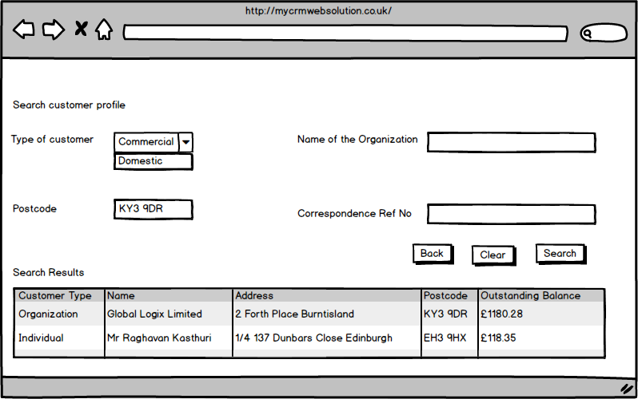
3) Synchronous Request-Response Web Service call Customer Search module of BSkyB CRM solution
Customer search by one or more parameters to display customer search results within a few seconds of clicking the “Search” button. A synchronous web service call expecting a response in seconds of placing the request.
Clicking on “Search” button from web screen of CRM invokes customerSearch (String customerName, String postCode, String businessName, String correspondenceRefNo) returns an array of customers who match the search criteria.

Slide 5
4) Asynchronous Fire & Forget Web Service call Customer calls BSkyB call center to request duplicate copy of a letter
Once customer is located on CRM, correspondence link displays all inbound and outbound correspondences. Clicking on “Resend” button invokes 2 things:
1) A work item is created for an agent to post the letter and mark the work item as complete &
2) A print request is sent to the print factory for the letter to be printed with “DUPLICATE” stated on the correspondence.
For the above 2 things to happen, it would take a number of days and the screen can't afford to wait on a response but return the control back to the page displaying, the duplicate copy request is received and shall be processed in “X” numer of days.
This is an Asynchronous Fire & Forget Web Service call. In other words, there isn't a way of confirming immediately that the request is complete by clicking the “RESEND” button.

Slide 6
5) Messaging MQ and Java Messaging Service
Child Trust Fund (CTF) project at Capgemini ASPIRE
I worked on Child Trust Fund (CTF) project on the Capgemini ASPIRE account.
Interaction and message flows between Child Trust Fund (CTF) and Child Benefit Application was achieved through Java Messaging Service (JMS) and Message Driven Beans. National Insurance Number (NINO) was the unique identifier.
Child Trust Fund System
Message driven beans
Child Benefit
System

Slide 7
6) Web Services Definition Language
A fraction of Online Registration WSDL while at KCom
<message name="registerOnlineRequest">
<part name="term" type="xs:string"/>
</message>
<message name="registerOnineResponse">
<part name="value" type="xs:string"/>
</message>
<portType name="OnlineRegistration">
<operation name="registerOnline">
<input message="registerOnlineRequest"/>
<output message="registerOnlineResponse"/>
</operation>
</portType>

Slide 8
7) Java API for RESTful Web Services
National Lottery games enhanced at Camelot Group
Web application developed enabling users to play National Lottery games online is an example of Java API for RESTful web services.
IDE used was both Eclipse and Netbeans.
The RESTful services were created using Spring Model View Controller framework and business logics in Enterprise Java Beans (Stateless Session Beans).
The standard HTTP methods of GET, PUT, POST, DELETE.
Unlike SOAP, doesn't have to use XML for request and responses.

